Slide 1
WAS 서버

Slide 2
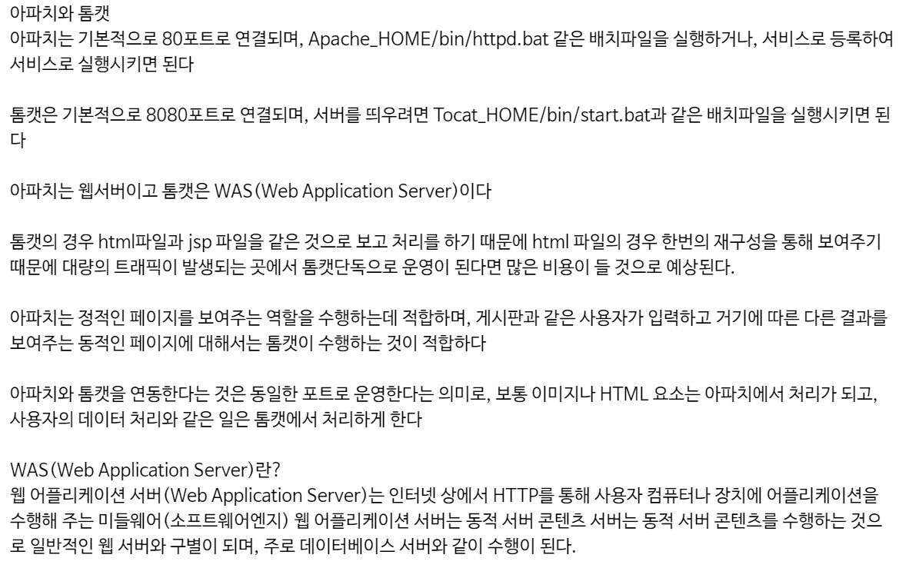
아파치의 역사

Slide 3
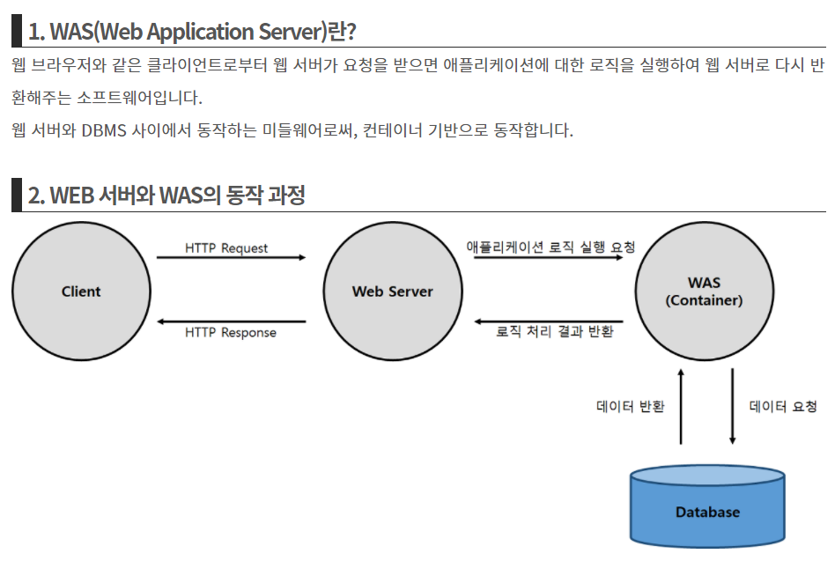
WAS(Web Application Server)

Slide 4
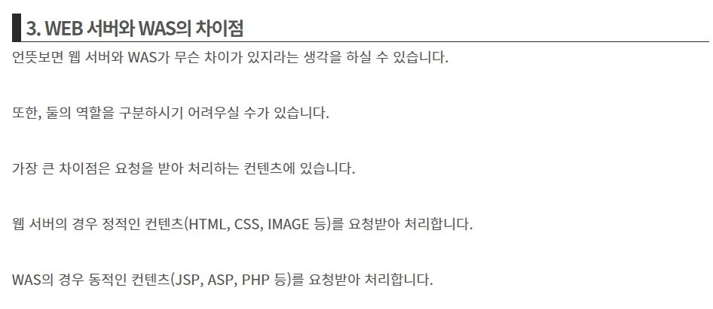
WAS(Web Application Server)

Slide 5
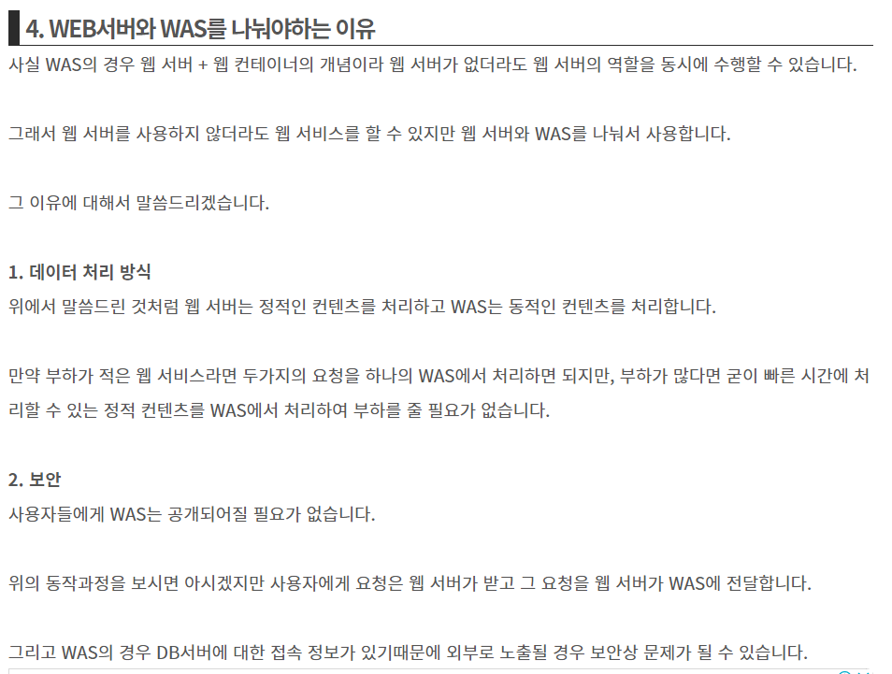
WAS(Web Application Server)

Slide 6
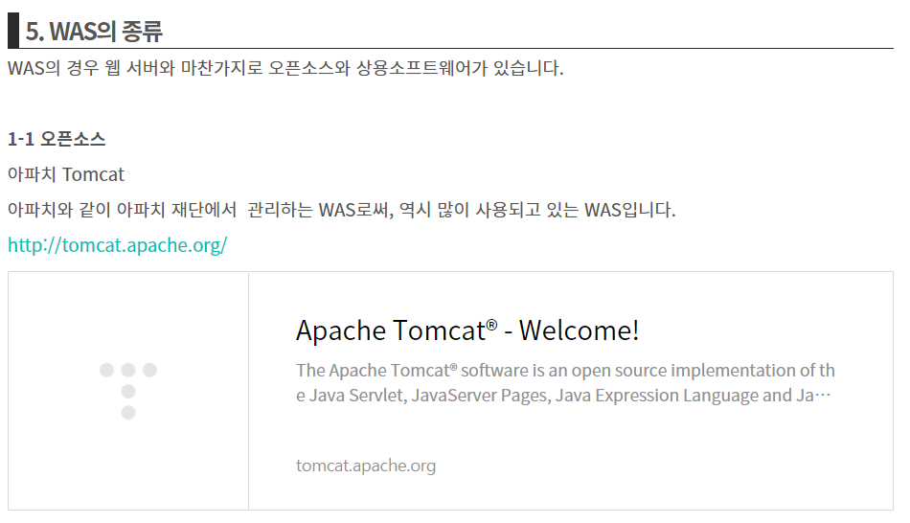
WAS(Web Application Server)

Slide 7
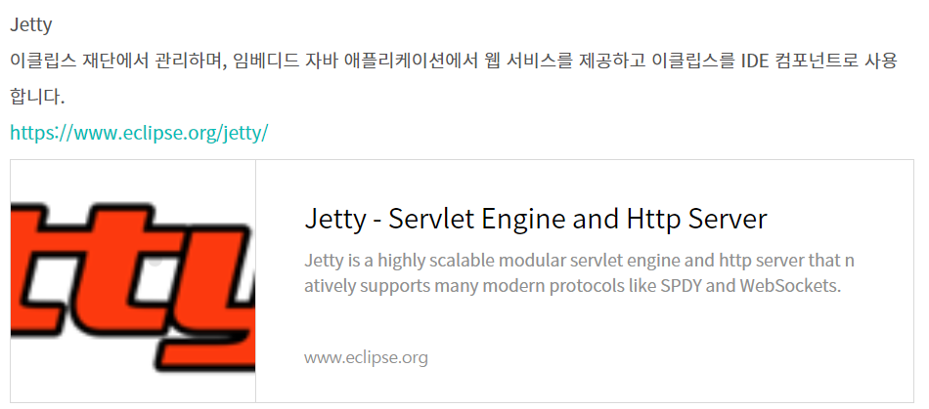
WAS(Web Application Server)

Slide 8
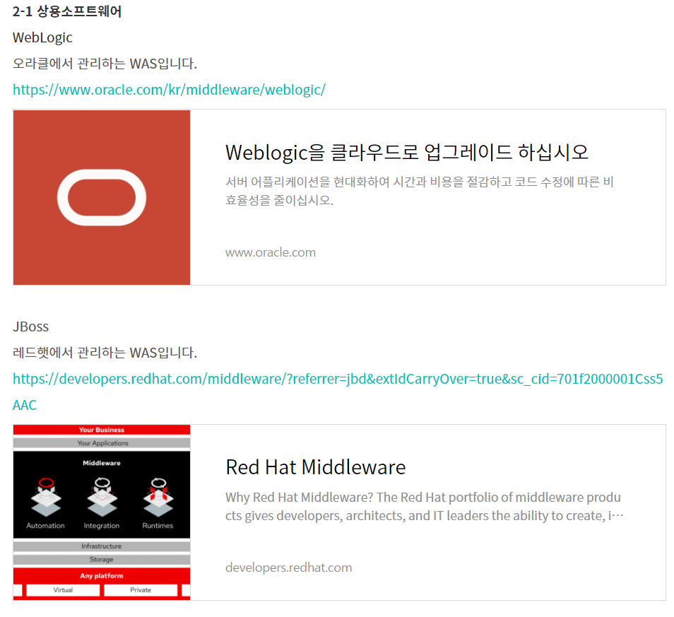
WAS(Web Application Server)

Slide 9
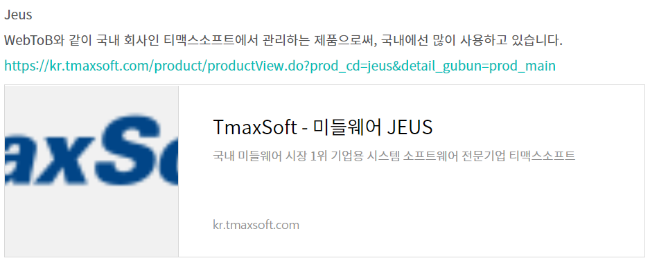
WAS(Web Application Server)

Slide 10
WEB Server VS WAS Server

Slide 11


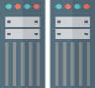

WEB Server VS WAS Server 개념도
Request
Request
Request
Response
Response
Response
DB Server
Client
Web Server
Was Server
■
Client Side Language
■
Server Side Language
HTML
XML
Java Script
JQuery
CSS
JSTL
JSP
Java
■
Web Server 종류
■
Was Server 종류
Apache HTTP Server
WebTob (Tmax)
IIS (마이크로소프트)
Google Web Server
Node.js
Tomcat
Jeus (Tmax)
WebLogic (Oracle)
WebSphere (IBM)
JBoss (RedHat)
Resin (Caucho)

Slide 12
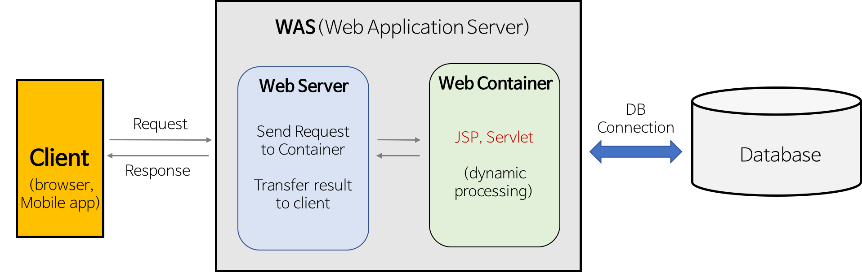
WEB Server VS WAS Server 기능
■
Web Server 기능
■
Was Server 기능
클라이언트 세션 관리
클라이언트 요청 관리
클라이언트 응답 관리
HTTP, HTTPS 프로토콜 연결
Web Server의 요청 처리
트랜잭션 관리
DB Connection Pool 관리
GC 관리
Log 관리

